Slide 1

School of Computing Science and Engineering
Course Code : BTCS4801 Course Name: Research Methodology & IPR
Unit III
TECHNICAL WRITING
Name of the Faculty: Dr. Balbindar Kaur Program Name: B.Tech

Slide 2
Effective technical writing
Technical writing is communication, the primary aim of which is to convey a particular piece of information to a particular reader or group of reader for a practical purpose.
Technical writers design, write, and edit documents for engineering, scientific, industrial and government organization.
These include technical report, computer manuals, brochure, proposal, technical specification, educational and training materials.

Slide 3
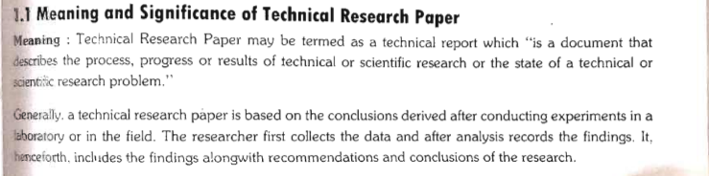
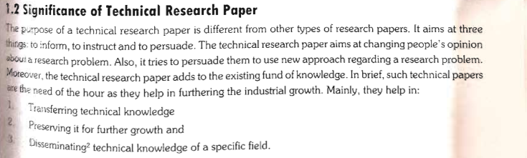

Slide 4


Major Components Of Effective Communication
Message
Mapping of references
Who
Why
Writer/ Speaker
What
How
Audience

Slide 5
Interaction with Audience
Effective communication is not only delivering message but also includes questions and answers
Who are you addressing?
Why is your message important?
What is your “take home “message?
How to best deliver your message and satisfy the
audience?
Popular science writing is equally important as communicating your research results in science journals

Slide 6
Major steps in research process
Reading literature for the topic of research
Identification of what is known /unknown.
Formulation of problem resulting in testable hypothesis
Collection of data through experimentation or interviewing people (design materials and methods)
Analysis of data and interpretation
Conclusion drawn (a new patch is added to the knowledge puzzle)leading to new approaches(cycle)
a scientific publication and other forms of communication

Slide 7
Main sections of a scientific paper
Most scientific journals follow a standard format i.e.,
Title
Abstract
Introduction
Materials and Methods
Results
Discussion
Conclusion
References
Acknowledgement/supplementary material/tables/figures are optional
Sometimes Results and Discussion are combined in one section, theory may replace materials and methods.

Slide 8
Title
Title should be catchy to attract people to read it
It should be informative (mention subject ,not results).
It should be specific (different from others)
It should be concise, otherwise give a short working title separately.
It should reflect the whole content of paper
No abbreviations or meaningless words
Conference paper title should be indicative of the session

Slide 9
Abstract & Key words
Most important, should be indicative for audience to read the whole paper or reject
Abstract indicates objectives of research and suggests results in general terms.
It makes reader inquisitive so he/she want to read it.
An informative abstract describes the research problem and supports conclusion with data.
It should stand alone without referring to full paper.
Start briefly with motivation, justification(present tense) ,state objectives (past tense), continue with approach, main results (past tense) and end with important conclusions and impact (present tense).
Key words must form the subject index of the journal and best describe your research

Slide 10
Introduction
Introduction should make it clear to the reader that topic is important and objective is justified.
Should provide necessary background
Explain rationale of study, clearly stating objectives and approach
Relevant literature should be summarized briefly with references
State the gap between known and unknown, how question has been answered and hypothesis answered
Review papers have generally short introduction followed with long discussion of literature with appropriate headings and subheadings
Objectives (past tense) and review of literature (past tense or present perfect tense), motivation/justification (present tense)

Slide 11
Materials and Methods
Must provide clear, concise and complete description for experimental , analytical and statistical procedures.
Give source /quality/catalogue no. of materials/chemicals and name and model of equipment used
An already published procedure should not be described in detail, only give reference but mention modifications.
Should be written in such a way that any other researcher can repeat it.
State quantities in standard units
Microorganisms must be named by genus, species and strain
For enzymes EC no. (Enzyme commission no.)should be given
For drugs chemical names should be used not trade names
Sampling procedures to be given for surveys
For data analysis mention software used along with mathematical model(s) and statistical methods used

Slide 12
Results and Discussion
May be separate or combined (see instructions to authors)
If separate , give summary of your research (only results) no comparisons
If combined give comparison with literature
Results can be best written in the form of figures and tables (select the most important and send the rest as supplementary material).
Data from tables need not be repeated in text
Results can be expressed as Means and standard deviations from data in tables

Slide 13
Results and Discussion cont….
Results should be interpreted clearly, concisely and logically under discussion section (no repetition of data)
Results should be correlated with objectives
Mention whether literature report supports or contradicts your results. Give logical explanation for contradictions.
Importance of negative (non-significant) results must also be given.
Limitations of your work e.g. design of experiment, statistical analysis etc. should be mentioned
Results to be written in past tense, interpretation of results in present tense and literature citation in past tense.
Combining Results and Discussion can avoid repetition

Slide 14
Conclusions
Summary of research results and their meaning in general. No extrapolation
Interpretation of the impact of research results.
No reference to literature.
Future plan of work
Present tense

Slide 15
Acknowledgements
General and specific
General: Gratitude to Institute, laboratory or sponsoring agency
Specific: For colleagues, technicians or reviewer
Dedication
Whether part of thesis or dissertation

Slide 16
References
Citation in text or reference list should be in accordance with the style of the journal
All references in the list should be mentioned in the text and visa versa
Latest publications upto the year of paper submission must be mentioned.
If numbered in the text sequence must be followed
EndNote is the industry standard software tool for publishing and managing bibliographies, citations and references on the Windows and Macintosh desktop.

Slide 17
Appendix (Supplementary material)
Material which is not essential for understanding paper but is helpful.
Examples are, derivations of mathematical formulae or proofs, questionnaires, details of analytical procedures like spectral data, new computer programs, algorithms etc.
May be procured from author on a web site, if address is available

Slide 18
Precautions for Writing research Report
Clear Objectives and Research Questions: Clearly define the objectives and research questions of your study. This will guide your research and help you maintain focus throughout the report.
Thorough Literature Review: Conduct a comprehensive literature review to understand the existing body of knowledge related to your research topic. This will help you identify gaps in the literature and position your research within the context of existing research.
Ethical Considerations: Ensure that your research adheres to ethical guidelines and principles. If your study involves human subjects, obtain necessary ethical approvals and informed consent. Respect privacy, confidentiality, and cultural sensitivities.

Slide 19
Research Design and Methodology: Clearly explain the research design, methodology, and data collection methods you used. Justify your choices and provide sufficient details so that the study can be replicated by others.
Sample Selection and Bias: Describe the process of sample selection, including the criteria used and potential sources of bias. Acknowledge any limitations and address how they might impact the results.
Data Collection and Analysis: Explain how you collected and analyzed your data. Clearly outline the statistical or analytical techniques used and provide any relevant formulas or equations.
Results Presentation: Present your results in a clear and organized manner. Use tables, graphs, and charts to illustrate key findings. Avoid selective reporting by including all relevant results, even if they don't support your hypothesis.

Slide 20
Discussion of Results: Interpret your results in the context of your research questions and objectives. Discuss any unexpected findings, compare your results with previous research, and explain the implications of your findings.
Limitations: Acknowledge the limitations of your study. This could include issues with sample size, data collection methods, biases, or external validity. Discuss how these limitations might affect the interpretation of your findings.
Conclusion and Recommendations: Summarize the key findings of your study and restate the implications. If appropriate, provide recommendations for further research or practical applications.

Slide 21
Citation and Referencing: Properly cite all sources you have referenced in your report. Use a consistent citation style (such as APA, MLA, Chicago) and ensure that your citations are accurate.
Proofreading and Editing: Thoroughly proofread and edit your report for grammatical errors, clarity, and coherence. Consider seeking feedback from colleagues or mentors to catch any overlooked mistakes.
Plagiarism Check: Use plagiarism detection tools to ensure that your report does not contain any unintentional instances of plagiarism.
Consistency and Formatting: Maintain a consistent formatting style throughout the report. Use headings, subheadings, and formatting elements to make the report visually appealing and easy to navigate.
Peer Review: If possible, have your report reviewed by peers or experts in the field before finalizing it. Their feedback can help you improve the quality and credibility of your research.

Slide 22
Research Proposal
A research proposal is a document that outlines how you propose to undertake your research studies.
A research proposal is a document written by a researcher that provides a detailed description of the proposed program.
It is an outline of the entire research process that gives a reader a summary of the information discussed in the project.
Research proposal is able to give a overview of the research project so that other people understand the significance of a research, scope and objectives of the research as well as the research methodology .

Slide 23
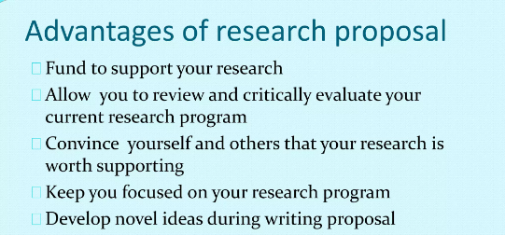

Slide 24
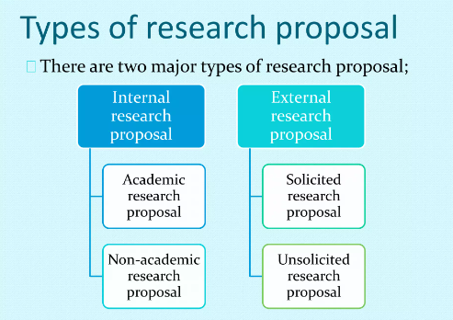

Slide 25
How long should my research proposal be?
It should be 2,000–3,500 words (4-7 pages) long.
What should be included in my research proposal?
Proposal should include the following:
1. TITLE: Title should give a clear indication of your proposed research approach or key question
2. BACKGROUND AND RATIONALE
The background and issues of the proposed research identify the discipline, a short literature review, a summary of key debates and developments in the field.
3. RESEARCH QUESTION(S) One should formulate these clearly, giving an explanation as to what problems and issues are to be explored and why they are worth exploring
4. RESEARCH METHODOLOGY: Provide an outline of:
the theoretical resources to be drawn on.
the research approach (theoretical framework)
the research methods appropriate for the proposed research
a discussion of advantages as well as limits of particular approaches and methods

Slide 26
5. PLAN OF WORK & TIME SCHEDULE
One should include an outline of the various stages and corresponding time lines for developing and implementing the research, including writing up your thesis.
For full-time study your research should be completed within three years, with writing up completed in the fourth year of registration.
For part-time study your research should be completed within six years, with writing up completed by the eighth year.
6. BIBLIOGRAPHY: Should include:
a list of references to key articles and texts discussed within your research proposal
a selection of sources appropriate to the proposed research

